Slide 1
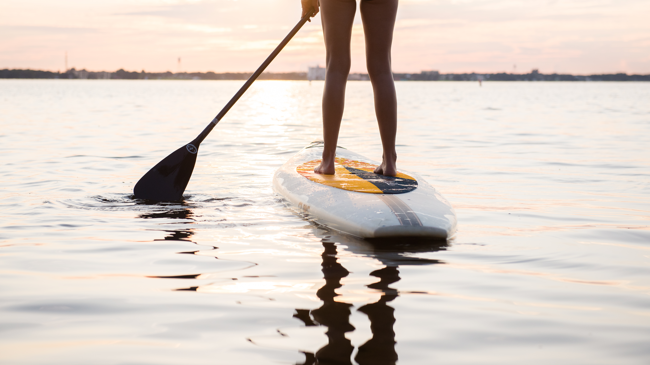
Highlands County Tourist Development Council Strategic Plan & Conversation FY2020 - FY2023
Notes:
1. draft
2. mix of new ideas and old ideas

Slide 2
Strategic Planning Elements
Awareness and Perception Research
Individual Stakeholder Interviews
Community Stakeholder Interviews
Product Evaluation
Situational Analysis

Slide 3
Awareness and Perception Research
Sebring
Lake Placid
Avon Park
Not at all familiar: 26 percent
Some degree of familiarity:
74 percent
(baseline)
Not at all familiar:
38 percent
Some degree of familiarity:
62 percent
(-12 percentage points)
Not at all familiar:
43 percent
Some degree of familiarity:
57 percent
(-17 percentage points)
Notes:
Interviewed individuals that traveled in the past 6 months in Sarasota, Tampa, Orlando, Miami

Slide 4
Awareness and Perception Research
Sebring
Not at all Familiar: 26 percent
Some degree of Familiarity: 74 percent
Lake Placid
Not at all Familiar: 38 percent
Some degree of Familiarity: 62 percent
Avon Park
Not at all Familiar: 43 percent
Some degree of Familiarity: 57 percent
(baseline)
(-12 percentage points from the baseline)
(-17 percentage points from the baseline)

Slide 5
Stakeholder Meetings
Individual interviews with community stakeholders
Group interviews with community stakeholders
Survey instrument distributed to stakeholders

Slide 6
Product Evaluation – Google Audit
Incomplete profiles, 47 percent
Unverified contact information, 64 percent
Missing hours, 64 percent
Needs better photos, 90 percent
Notes:
Gap in business practices. I.e. no credit cards.
Lakes – lack of rentals, amenities are difficult to access.

Slide 7
Product Evaluation – Continued
Gaps in business practices
No credit cards / debit cards accepted
Amenities are difficult to access (boat rentals)
Night-time activities are limited
Notes:
.

Slide 8
Product Evaluation – Continued
Absorption
Educational
Active Participation
Escapist
Immersion
Esthetic
Passive Participation
Entertainment
Missing
Inconsistent
Inconsistent
Missing
DIY components
Lack of continuity
Seasonal
Hidden facts

Slide 9
Product Evaluation – Continued
Educational components
Information about assets and experiences are often missing, or hidden.
Escapist components
Escapist
Immersion
Esthetic
Passive Participation
Entertainment
Inconsistent
Inconsistent
Missing
DIY components
Lack of continuity
Seasonal
If educational information is known, it is not widely distributed.

Slide 10
The Three Failures
Failure of Vision(Strategy)
Failure of Mission (Marketing/PR Plan)
Failure of Tactics
Notes:
The ability to say 'No' is just as important as the opportunity to say 'Yes'. Strategic plans should serve as a platform for stakeholder success, as well as a rulebook for participation. Essentially, something for everyone but not everything for everyone.

Slide 11
Highlands County Tourist Development Council Strategic Plan
Notes:
Pause for questions. Say again: some new, some familiar. These are bold concepts, not traditional, but certainly the way forward for destinations, also based on our stakeholder interviews.

Slide 12
Vision Statement
The Highlands County Tourist Development Council (TDC) inspires research-based decision making which leads to the type of tourism destination development that inspire future generations to remain in the community, and not move out of town.
The Highlands County Tourist Development Council allocates resources in order to enhance the quality of life for residents; including efforts to reduce seasonal employment and to create a place for families to raise their children.
Notes:
Vision: what gets us up in the morning without an alarm clock.

Slide 13
Mission Statement
To contribute to a positive quality of life for the residents of Highlands County (our customer) through destination promotion, tourism development, advocacy, and resource management – which are foundation pieces for future economic growth.
Previous mission statement: To promote Highlands County as a friendly, attractive and diverse destination for tourism, thus creating a positive economic impact benefiting the entire community.
Notes:
Once we're up, here is what we have to do.

Slide 14
Brand Promise
The Highlands County Tourist Development Council allocates resources and inspires consensus building, which allow community stakeholders to increase the quality of life for residents of Highlands County – through tourism, destination promotion, development, advocacy and resource management.
Notes:
Emphasize resources is Time, Talent, Treasure, Tribe. Not grants.

Slide 15
Strategic Priorities (Over the next three years the organization will focus on the following key projects and program areas):
Digital First (and Second)
Leverage Brand Awareness and Perception, through Public Relations and Influencer Marketing
Amplify Experience Economy & Creative Placemaking Constructs
Cultivate a Reputation for Stakeholder Training and Community Sharing
Encourage Efficient use of Administrative Resources
Conservative Principles for Destination Development / 4th Penny

Slide 16
A. Digital First (and Second)
Shift advertising spend
Inventory all print assets in the destination (for example, any guides, guidebooks, attraction brochures – Art and Culture Passport)
Fund the creation of parallel digital assets
Prioritize digital asset creation (and distribution)
Integrate digital assets into marketing and public relations efforts
Notes:
Build image library

Slide 17
B. Leverage Brand Awareness and Perception through Public Relations and Marketing
Media FAM
Media Relations
Editorial, Sweepstakes, Destination Spotlight
Targeted email
Storytelling
Influencer
Notes:
Notes: By brand awareness, we specifically mean to leverage the high levels of awareness for the town of Sebring. It is known that a destination can excel when its iconic namesake is amplified. Lake Placid and Avon Park, along with 'Highlands County' and 'Heartland' are simply not registering as a place for a leisure vacation in the minds of travelers in our target markets.
By public relations, we specifically mean the business of inducing the public to have understanding for and goodwill toward the destination. It is 'positioning' the destination properly via verbal and non-verbal cues.

Slide 18
C. Amplify Experience Economy & Creative Placemaking Constructs
Absorption
Educational component
Active Participation
Escapist component
Immersion
Esthetic component
Passive Participation
Entertainment component
Notes:
Theme the experience: an effective theme is concise and compelling. It is not a corporate mission statement or a marketing tag line. Every detail is attended to.
2. Harmonize impressions with positive cues: these affirm the nature of the experience to the guest. Each cue must support the theme, and none should be inconsistent with it.
3. Mix in memorabilia: if there is no demand for your memorabilia, it is because you are not staging engaging experiences. Customers will pay a premium for memorabilia that acts as a physical reminder of an experience.
4. Engage all five senses: the more senses an experience engages the more effective and memorable it can be.

Slide 19
C. Amplify Experience Economy & Creative Placemaking Constructs
Identify the Community's Assets and Strengths
Integrate the Arts Into Design, Construction and Engineering
Marketing to Cultivate Ownership and Pride
Incorporate stakeholder groups in Public and Advisory Meetings
Notes:
5. Identify the Community's Assets and Strengths. Sports Tourism Index. The goal of cultural asset mapping is to identify what is already present in the community. For example, a master list of assets, the markets these assets aim to serve, and the unique features present in each asset.
6. Integrate the Arts Into Design, Construction and Engineering. Artists can provide fresh approaches and new ways of doing things, providing fresh thinking for existing programs. For example, most projects include a project manager and budget analysis. An arts representative could also add to the discussion for these projects. Post card murals.
7. Marketing to Cultivate Ownership and Pride. Drawing upon significant local landmarks or features to help create an exciting rallying point for a project. For example, the water tower, public signs, murals, and other visual features of the destination.
8. Incorporate Arts in Public and Advisory Meetings. Artists can bring new ideas and formats to the public engagement process. For example, having representatives present at meetings to share and engage the community in a setting different than their usual environment.

Slide 20
More than a meeting!
Look at Mike. Showing off his golf skills before a stakeholder meeting.
Mike shared his knowledge about the putting surface.
He was an active participant.
He dressed the part.
He had fun.

Slide 21
D. Cultivate a Reputation for Stakeholder Education
A culture of training
Model the way
Proof of concept
Activation
Notes:
Add photo from golf meeting
1. A culture of training. For example, bringing in subject matter experts, sharing newsletters, and hosting workshops.
2. Model the way. For example, council members, staff, and stakeholders can attend community events and industry segment conventions.
3. Proof of concept. For example, implementing new concepts at different events; sharing case-studies with other stakeholders. (Pace car in the lobby).
4. Activation. For example, provide a path for stakeholders to participate in future proof of concept testing and case-study sharing.
1. A culture of training. Multiple events for community stakeholders and industry segments.
2. Model the way. Attend community events and industry segment conventions.
3. Proof of concept. Implement learning at community events.
4. Activation. Provide a path for stakeholders to participate.
· Hospitality Training Certification
· Event Planner Seminar – FEAA
· Hotelier Education – FRLA
· Industry Education: Fall Lunch & Learn and May Tourism Luncheon
· Google Audit/maintenance with Miles Partnership - $7,500?
Partner Education/Outreach

Slide 22
E. Encourage Efficient use of Administrative Resources
A database system for storing leads and contacts
Ensure a transparent approval process for organizations seeking grant funding
Create a predictable workflow for allocating grant dollars
Plan Tourist Development Council Meetings on a Quarterly Basis

Slide 23
F. Conservative Principles for Destination Development / 4th Penny
Utilize current accounts with specific purposes (Lakes Account, Fishing tournament enhancements)
Incorporation other fundamentals of the plan: A-E
Encourage Experiential Enhancement of current assets
Multiple projects, not one mega-project
Notes:
Asset Development & Enhancement. Reminder that the community has in their mind that TDC will help fund the building of some mega project.

Slide 24
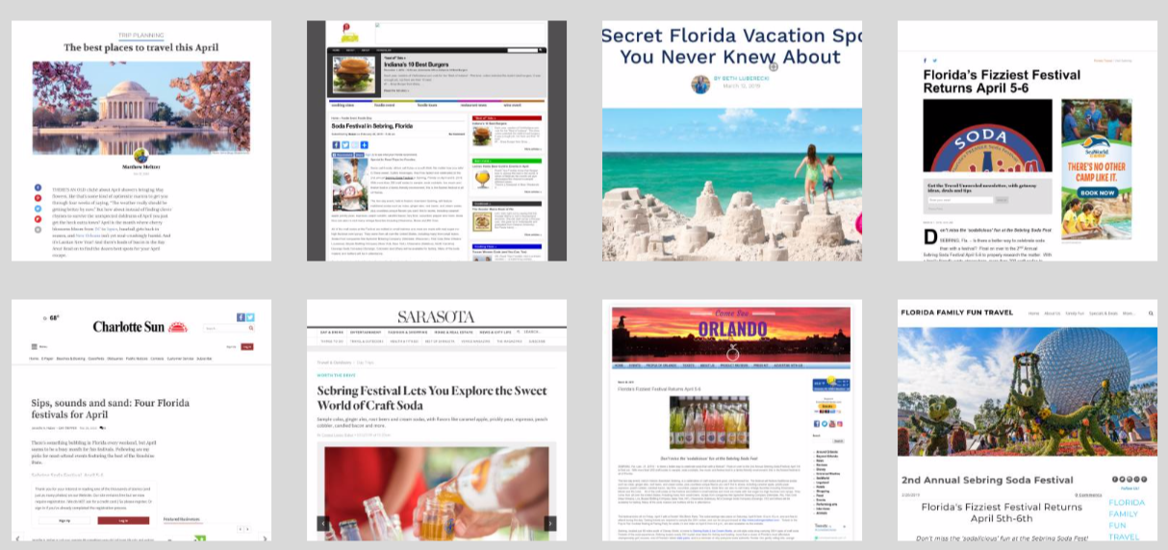
2018-2019 Major Accomplishments
Florida Huddle: Tour Operators & Media
Florida Encounter: Meeting & Conference Planners
Threshold 360 - 360 degree photos of all tourism partners on website
Tourism Luncheon – National Travel & Tourism Week
TDC Strategic Plan
New Events: Shepherd King, Michelin Encore, & Lake Placid Softball
Meetings/Events
ING Conference – golf media
World Amateur Golf Championship Final
Google Audit of Destination & Partners
Plus Educational Session & feedback for Local Industry Partners
Blog/Storytelling - new stories monthly on website
Postcard Murals
New Golf Course Photos
Soda Festival Media Coverage
49 pieces of coverage, 15.1 million online readership, 92.8K estimated coverage views, 301 social shares, 2.89k YouTube views

Slide 25
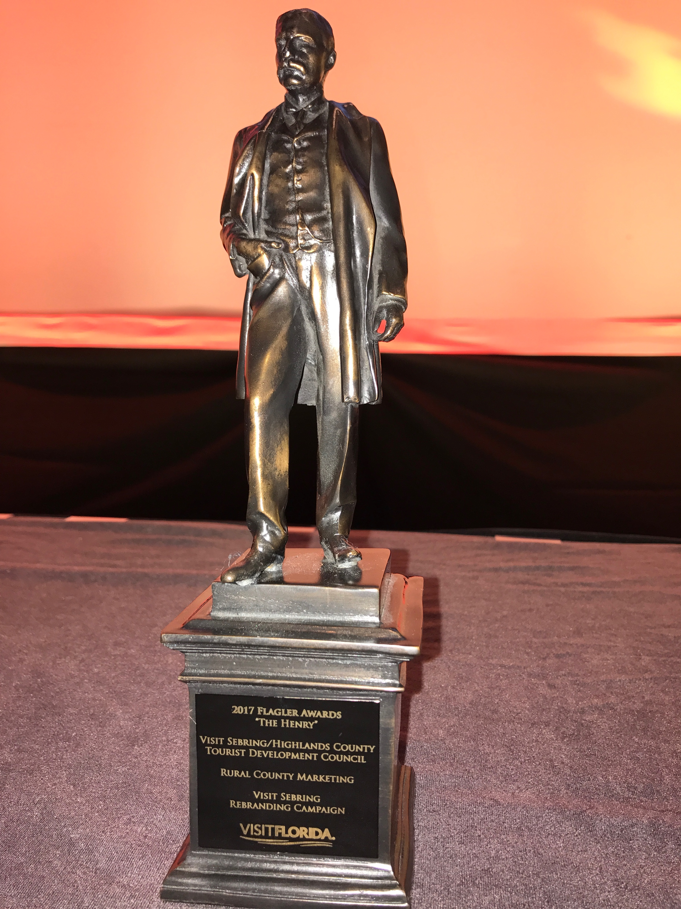
Public & Industry Relations
International Museum Day
Chinese Golf Tour Operators in September
Canbox – Chinese Travel show in December
Hosted media + influencers from Brazil, Canada & Florida
Hosted Canadian Meeting Planner in March
NYC PR firm for 3 months/Soda Fest
National Travel & Tourism Day – Tri-Chamber & EDC
Tourism Luncheon & Industry Education
VISIT FLORIDA
Promote free website listings to all local tourism partners
Submit to VF for most Media Opportunities
Respond to applicable opportunities from Florida Film Office
Social Media Opportunities - Twitter Chats & Direct Submissions
2nd “Henry” top award for excellence in Tourism Marketing from VISIT FLORIDA for the Citrus Golf Trail Marketing
Received Silver Award from HMSAI for Visit Sebring website
Joined FL Festival & Events Assn + FL Attractions Assn

Slide 26
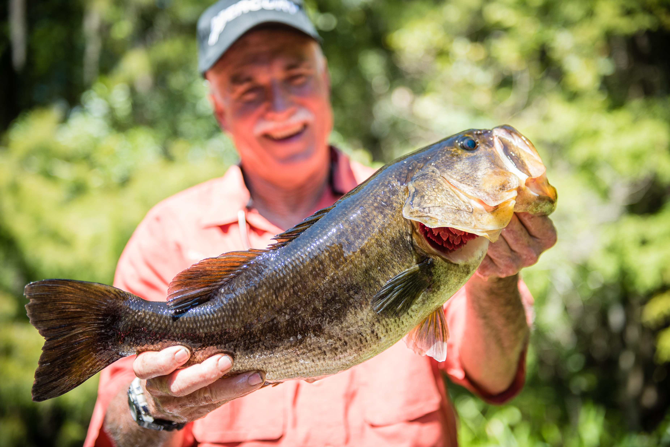
Stakeholder Meetings
Hotels/Accommodations
Result: Discussing each visitor experience, how we can work to improve those experiences and tell the story of each location + better communication between accommodation & TDC.
Three Chambers of Commerce
Result: Tourism Luncheon & ongoing communication
Highlands Hammock State Park
Result: County-wide Geotour & Kick Off Event
Sebring Soda Festival
Result: 3rd year event with coordinated marketing in conjunction with new event initiatives
Golf Courses
Result: Courses working together to strengthen Citrus Golf Trail brand and better position us as Golf Value Capital of America
Top 10 Reasons to Plan a Sebring Golf Vacation
Fishing Tournament Directors
Result: Developing a plan to improve fishing & fishing tournament facilities at both Windy Point and Istokpoga Park w/TDC’s designated Lakes Funds ($250,000)
Notes:
Also had one meeting with Racetrack

Slide 27
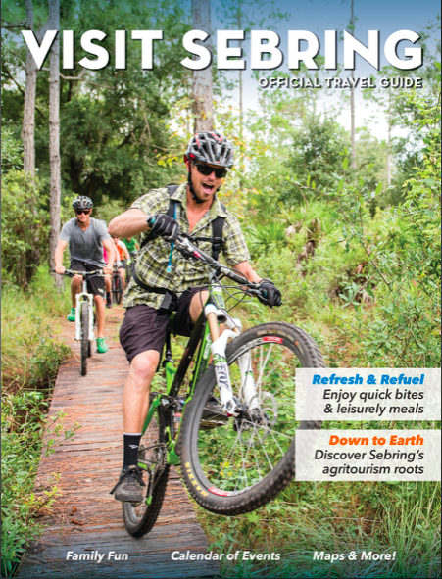
Major Initiatives for 2019-2020
Crowdriff – user generated photos
PR Firm – 12 months, county-wide
More earned media coverage, FAMs, etc.
Geo Tour + Kick Off Event
Visitor Profile – who is our visitor?
Sports Audit – index & evaluate our sports offerings; make recommendations for improvements & focus areas
Grant Program – making revisions to coincide with Strategic Plan
Professional Development for Industry Partners
Social media, event planning, etc.
Placemaking - more projects like Postcard Murals
Experiential Tourism - activations
Initiate 2021 Travel Guide– 50% of total price this FY
Digitalize all collateral in destination

Slide 28
2019-2020 TDC Marketing Budget
 | '18-19 Budget | ‘18-19 To Date | '19-’20 Proposed
Advertising | 140,000 | 150,863 | 200,000
A&C | 77,000 | 84,595 | N/A
Promotions/PR | 10,000 | 20,280 | 75,000
Library Upgrade | 15,000 | 18,350 | 30,000
Visitor Services | 30,000 | 18,481 | 60,000
Industry Relations | 20,000 | 3,853 | 18,000
Event Grant | 60,000 | 35,500 | 30,000
Website/SEO/SEM | 102,000 | 102,149 | 102,000
Special Projects | 80,000 | 74,779 | 100,000
TOTAL | $584,000 | $549,500 | $615,000

Slide 29
Highlands County Tourist Development Council Strategic Plan FY2020 - FY2023
Take action:
Review, Ensure, Approve!!

