Slide 1
Proposed 2020-2021 TDC Marketing Plan & Budget

Slide 2
TDC Strategic Plan: Vision & Mission
Vision: The Highlands County TDC inspires research-based decision making which leads to the type of tourism destination development that inspire future generations to remain in the community and not move out of town. The TDC allocates resources in order to enhance the quality of life for our residents; including efforts to reduce seasonal employment and to create a place for families to raise their children.
Mission: To contribute to a positive quality of life for the residents of Highlands County (our customer) through destination promotion, tourism development, advocacy and resource management – which are foundation pieces for future economic growth.

Slide 3
Strategic Pillars: Areas of Focus
Emphasis on digital assets & advertising
More PR/Media Relations to increase our Brand Awareness
Projects to make destination more appealing & engaging to visitors
>Incorporate Stakeholder Groups in Meetings
Industry Partner Engagement & Education
Streamline Administrative Duties
Enhancement Projects; start with Lakes (F)
>$250k in Lakes Account

Slide 4
2019-2020 Major Accomplishments
Revised Grant Program
Added Tourism Awards to Tourism Luncheon Program
Geotour Program & Landing Page
Lake Istokpoga Facility Improvements (in progress)
Crowdriff – user generated content/photos (UGC)
Sports Audit & Assessment
New Events
Geotour Launch (Moved from May to September)
GFNY – October
Adventure Race (December)
Phase 2: Google Audit of Destination & Partners
Fishing Influencers (in progress)
Bandwango (digital passports)
New Travel Guide (in progress)
Respond to COVID-19 situation
Social Media Training for Industry Partners

Slide 5
2020-2021 Areas of Focus
Emphasis on digital assets & advertising (A)
PR/Media Relations to increase Brand Awareness (B)
Attract more events (Experience Economy) to make destination more appealing & engaging to visitors (C)
Add Sports Stakeholder Group
Industry Partner/Tourism Employee Engagement & Education (D)
Sport Facility Enhancement Projects
What Sports Facilities Could We Easily Enhance to Bring More Tourists Here? (F)

Slide 6
TDC Plan: Strategic Priorities
Strategic Priorities
Emphasis and priority on digital assets & advertising
Leverage Brand Awareness & Perception through PR & Marketing
>Media FAMs, storytelling, influencers, UGC
Amplify the Experience Economy & Creative Placemaking Constructs
>Educational, escapist, esthetic & entertainment
Cultivate a Reputation for Stakeholder Education
Encourage Use of Efficient Administrative Resources
Conservative Principles for Destination Development/3rd Penny
>What Facilities Could We Easily Enhance to Bring More Tourists Here?
>Multiple projects; not one mega project
Ongoing Projects
Fishing Tournament Facility Improvements at Lake Istokpoga (F)
Host fishing influencers and activate their promotions/PR (B)
Oversee completion of new Travel Guide for 2021-2022
Host Tourism Education Event and distribute Tourism Awards (Sept. 2020) (D)
Crowdriff- use User Generated Content (UGC) to promote the destination (A)
Oversee/launch digital passports via Bandwango (A & C)
Oversee launch and promotion of Geotour (September 2020) (A & C)
Provide support to Event Planners for upcoming events (C)
GFNY – October 2020
Adventure Race – December 2020

Slide 7
TDC Plan: Strategic Priorities
Strategic Priorities
Emphasis and priority on digital assets & advertising
Leverage Brand Awareness & Perception through PR & Marketing
Amplify the Experience Economy & Creative Placemaking Constructs
Cultivate a Reputation for Stakeholder Education
Encourage Use of Efficient Administrative Resources
Conservative Principles for Destination Development/3rd Penny
New/Resumed Projects 2020-2021
Follow Recommendations (not yet completed) from Sports Audit
Explore Created Events Opportunities (Sports Event Creation) (C)
GFNY Marathon (October 2021+)
AJGA – Preview (April 2021-2023)
Symetra Golf Tournament (Sept. 2021-2023)
Citrus Golf Trail Tournament (Dec. 2021+)
Strengthen/Unify/Align Local Sports Community (D)
Build Relationships W/Potential Sporting Event Organizers & Influencers (C)
Focus on Facility Enhancement (F)
Continue industry stakeholder discussions once COVID concerns are reduced (D)
Art & Culture, Citrus Golf Trail, Fishing, Chambers of Commerce, Highlands Hammock/GeoTour, Hotels/Accommodations
Add new group: Sport Facilities & Stakeholders
Apply for Grant Funds from FL Sports Foundation, when applicable

Slide 8
Anticipated ‘20-’21 TDC Funds
$600,000 – collected to date (Oct. 2019-April 2020)
+$125,000 – anticipated (May-Sept. 2020) *Based on $25,000/mo.
$725,000
-$181,250 (25% of $725,000 = 3rd penny)
$543,750
-$140,000 – Operations (#5301)
$403,750
+$19,375 - canceled P0s for 2019-2020
+$12,500 – canceled Event Grants for 2019-2020
+$85,000 (TDC contingency fund)
$520,625 – amount available for TDC marketing ‘20-’21

Slide 9
Advertising
All Advertising - $210,000
Miles Media/FL Travel Guide
Digital Platforms:
Threshold 360
Crowdriff
Constant Contact
GeoTour/Geocaching
Facebook/Social Media Ads
Travel Guide (printing)
GFNY, Year #2
Photo & Video Library Upgrade
Graphic Design
VF Welcome Centers

Slide 10
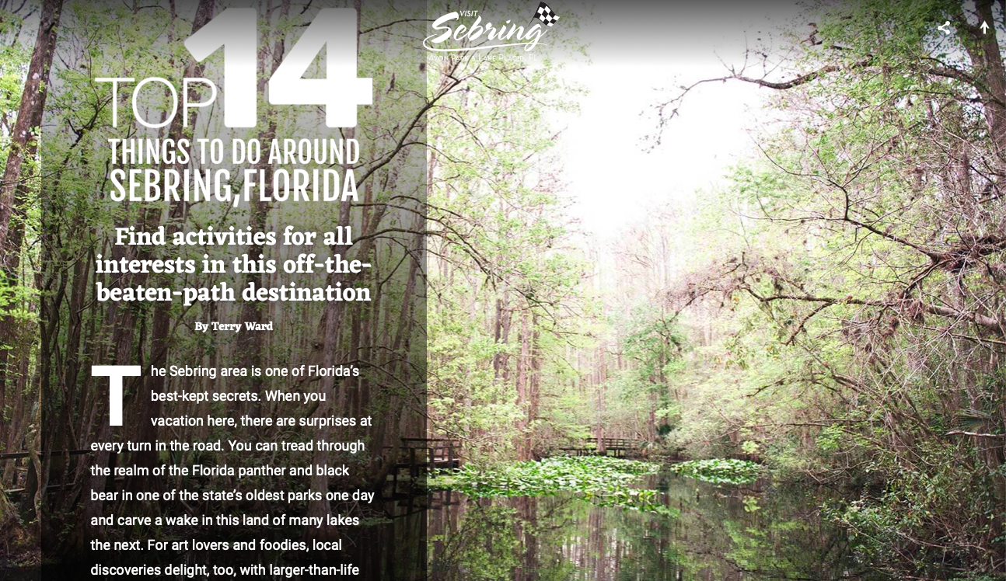
Website/SEM/SEO
Website $30,000
Enhancements $10,000
Hosting/Maintenance $20,000
SEO & SEM $72,000
SEM (paid)
SEO (organic)

Slide 11
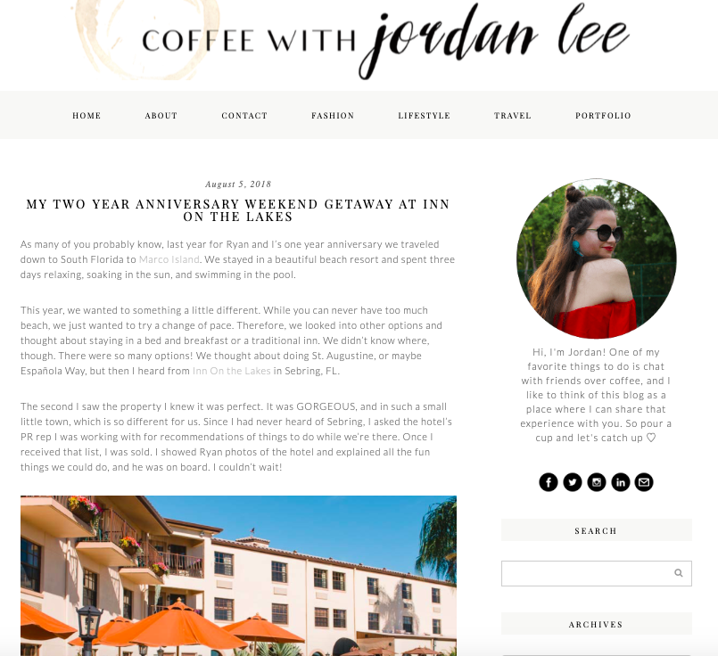
Promotions/PR
Promotions/PR $40,000
Media FAMs
Promotional Items
PR/Media Relations Firm
Influencers
Media Relations

Slide 12
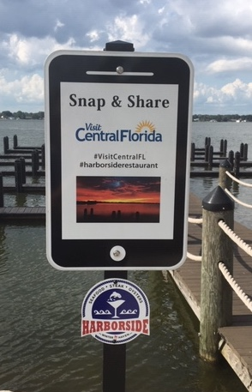
Visitor Services & Special Projects
Visitor Services $10,000
Bandwango – digital passports
Signage at Postcard Murals>>>
Printed Material
Only re-print Fishing/Lakes Guide (Acct. # 5307)
Special Projects $0
Follow Up: Sports Audit Recommendations
Re-design County’s welcome statues (fund in ‘21-’22)

Slide 13
Industry Relations & Grants
Industry Relations $8,000
Memberships & Conferences/Professional Development
VISIT FLORIDA
FL Assn. Destination Marketing Organizations (FADMO)
Florida Festival & Events Association (FFEA)
FL Sports Foundation
Tourism Luncheon & Awards Program
Stakeholder Meetings
Education/certification for local tourism partners & their employees
Travel News
Event Grants $150,000
America Jr. Golf Assn., Symetra Tour, Citrus Golf Trail Tournament, Dixie Youth, GFNY Marathon

Slide 14
Summary & Notes
Proposed 2020-2021 Budget: $520,000
2019-2020 Budget: $615,000
2018-2019 Budget: $584,000
2017-2018 Budget: $527,000
Budget Notes:
This budget is based on TDC activating $85,000 in contingency funds for 2020-2021.
TDC Consultant will apply for grant assistance through FL Sports Foundation for all sporting events we fund.
$12,500 in unused TDC grant funds (Dixie Youth, Caladium & Blueberry)
Cutting $19,375 in 2020/2021 in Nature ads/PR to save $.
Advertising and Photo/Video Library Upgrade categories were combined from last year.

Slide 15
Proposed 2020-2021 TDC Marketing Budget
 | '19-’20 Budget | ’19-’20 To Date | '20-’21 Proposed
Advertising | 200,000 | 217,372 | 210,000
A&C | N/A | N/A | N/A
Promotions/PR | 75,000 | 61,336 | 40,000
Library Upgrade | 30,000 | N/A | N/A
Visitor Services | 60,000 | 70,154 | 10,000
Industry Relations | 18,000 | 22,488 | 8,000
Event Grants | 30,000 | 0 | 150,000
Website/SEO/SEM | 102,000 | 102,000 | 102,000
Special Projects | 100,000 | 68,275 | 0
TOTAL | 615,000 | 577,785 | 520,000

Slide 16
Questions?

